Slide 1
EPA and PM2.5: No Science, No Bodies, Just Fraud
By Steve Milloy
Web: JunkScience.com
Twitter: @JunkScience
Email: milloy@me.com
January 10, 2023

Slide 2
The Key Question:
Does inhalation
of PM_{2.5}
kill or harm
anyone?

Slide 3
What is PM_{2.5}?
Airborne ‘fine particulate matter = ‘PM_{2.5}’
Dust or soot - alone or with gaseous material
Manmade
Smoke from smokestacks, tailpipes, chimneys, smoking, BBQs, fireplaces
Natural
Dust, pollen, mold, pet dander, wildfire smoke, volcanic emissions

Slide 4
Imagining PM_{2.5}

Slide 5
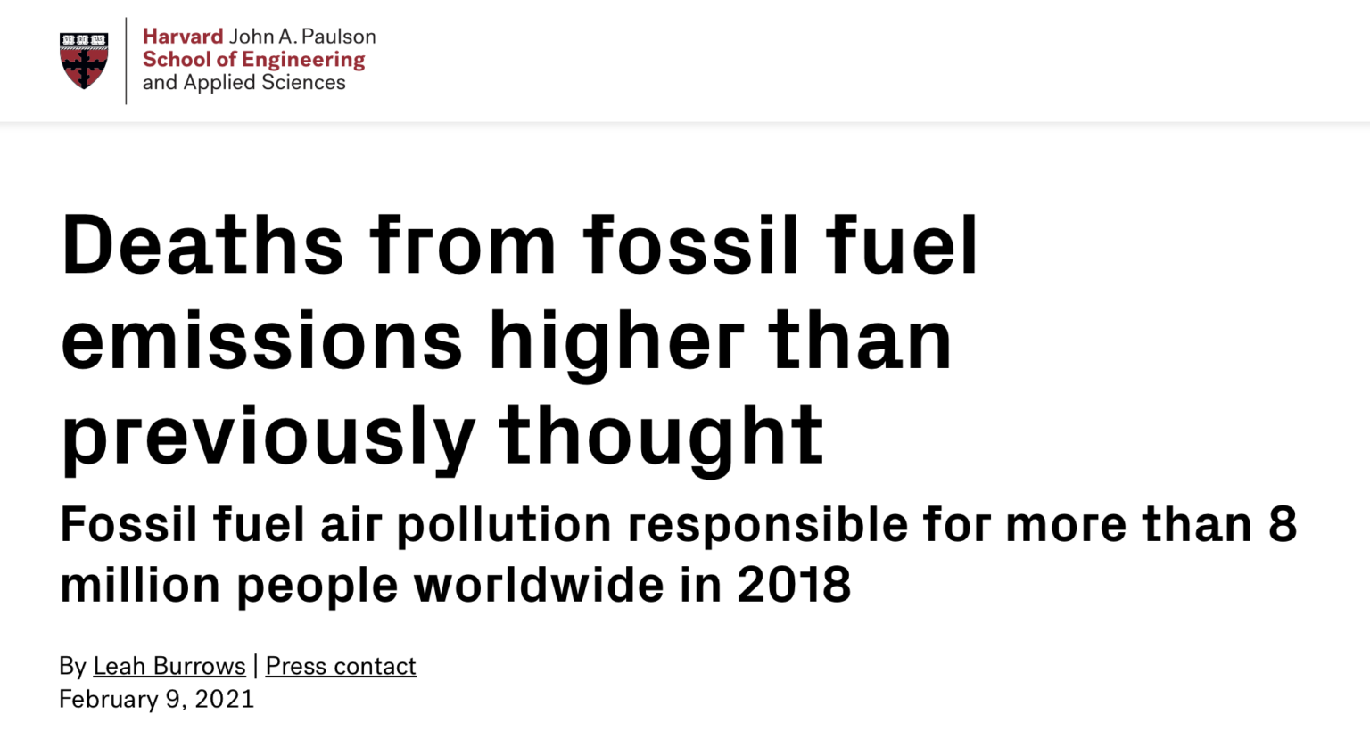
Why is PM_{2.5} important? Claim: 1 in 8 deaths worldwide

Slide 6
PM_{2.5} Reverse Weaponizes Cost-Benefit Analysis
EPA values every life at about $10 million, regardless of age at death.
EPA has attributed to PM_{2.5} as many as 570,000 US deaths per
So PM_{2.5} is potentially worth about $5.7 trillion in annual economic ‘benefits’ for EPA regulation

Slide 8
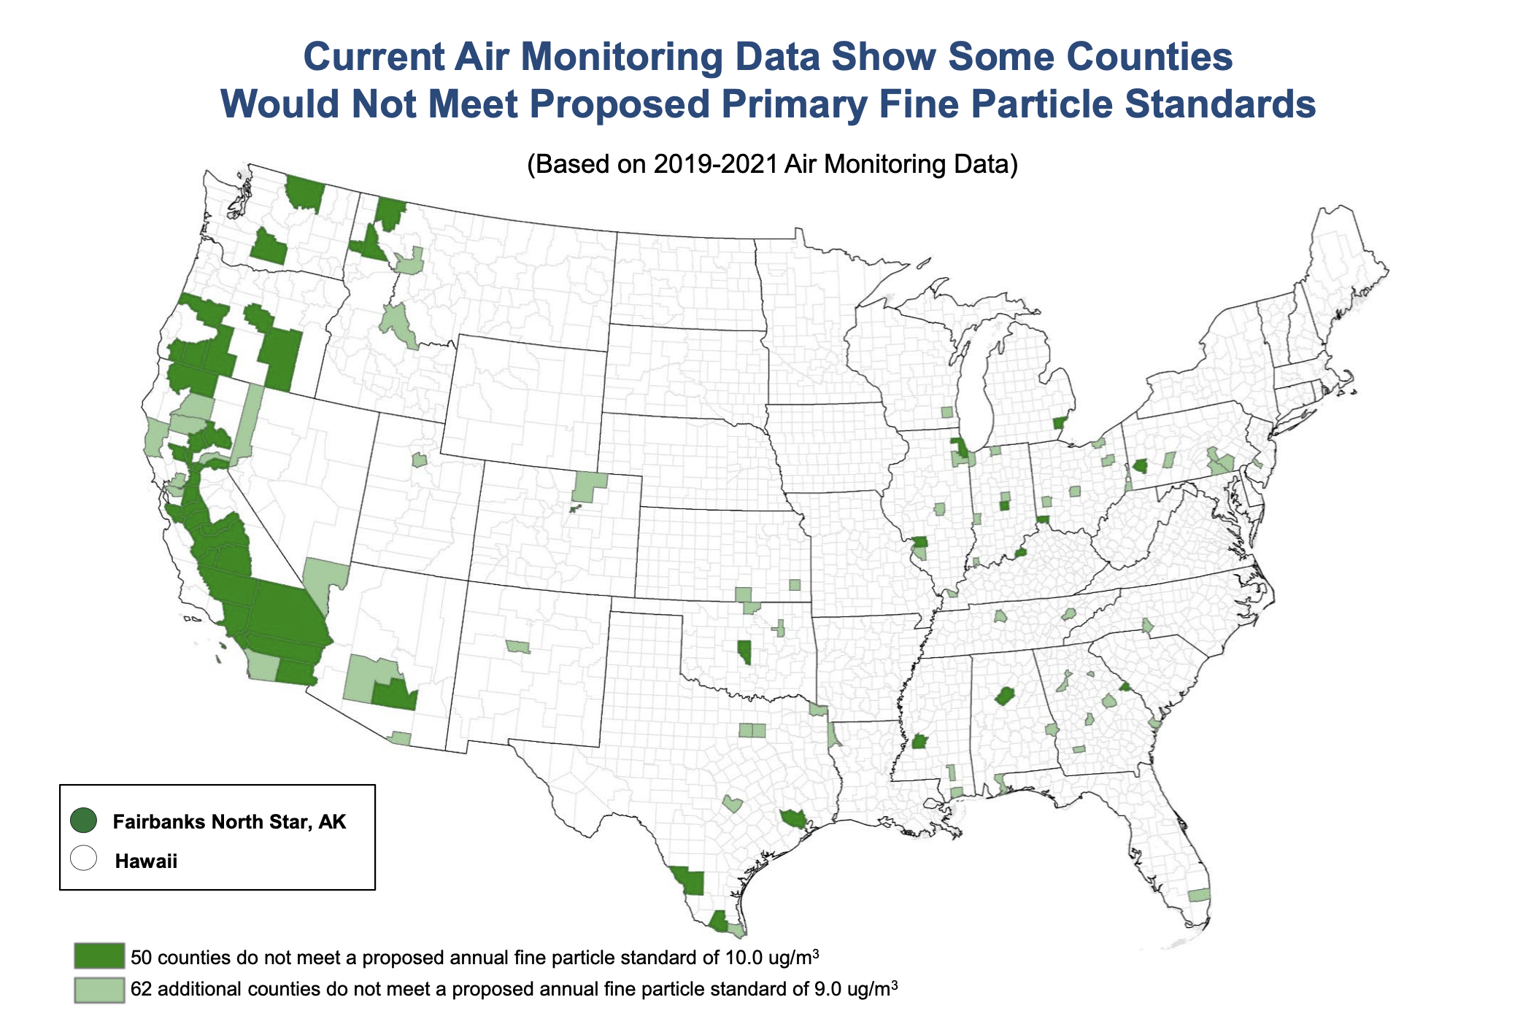

Slide 9
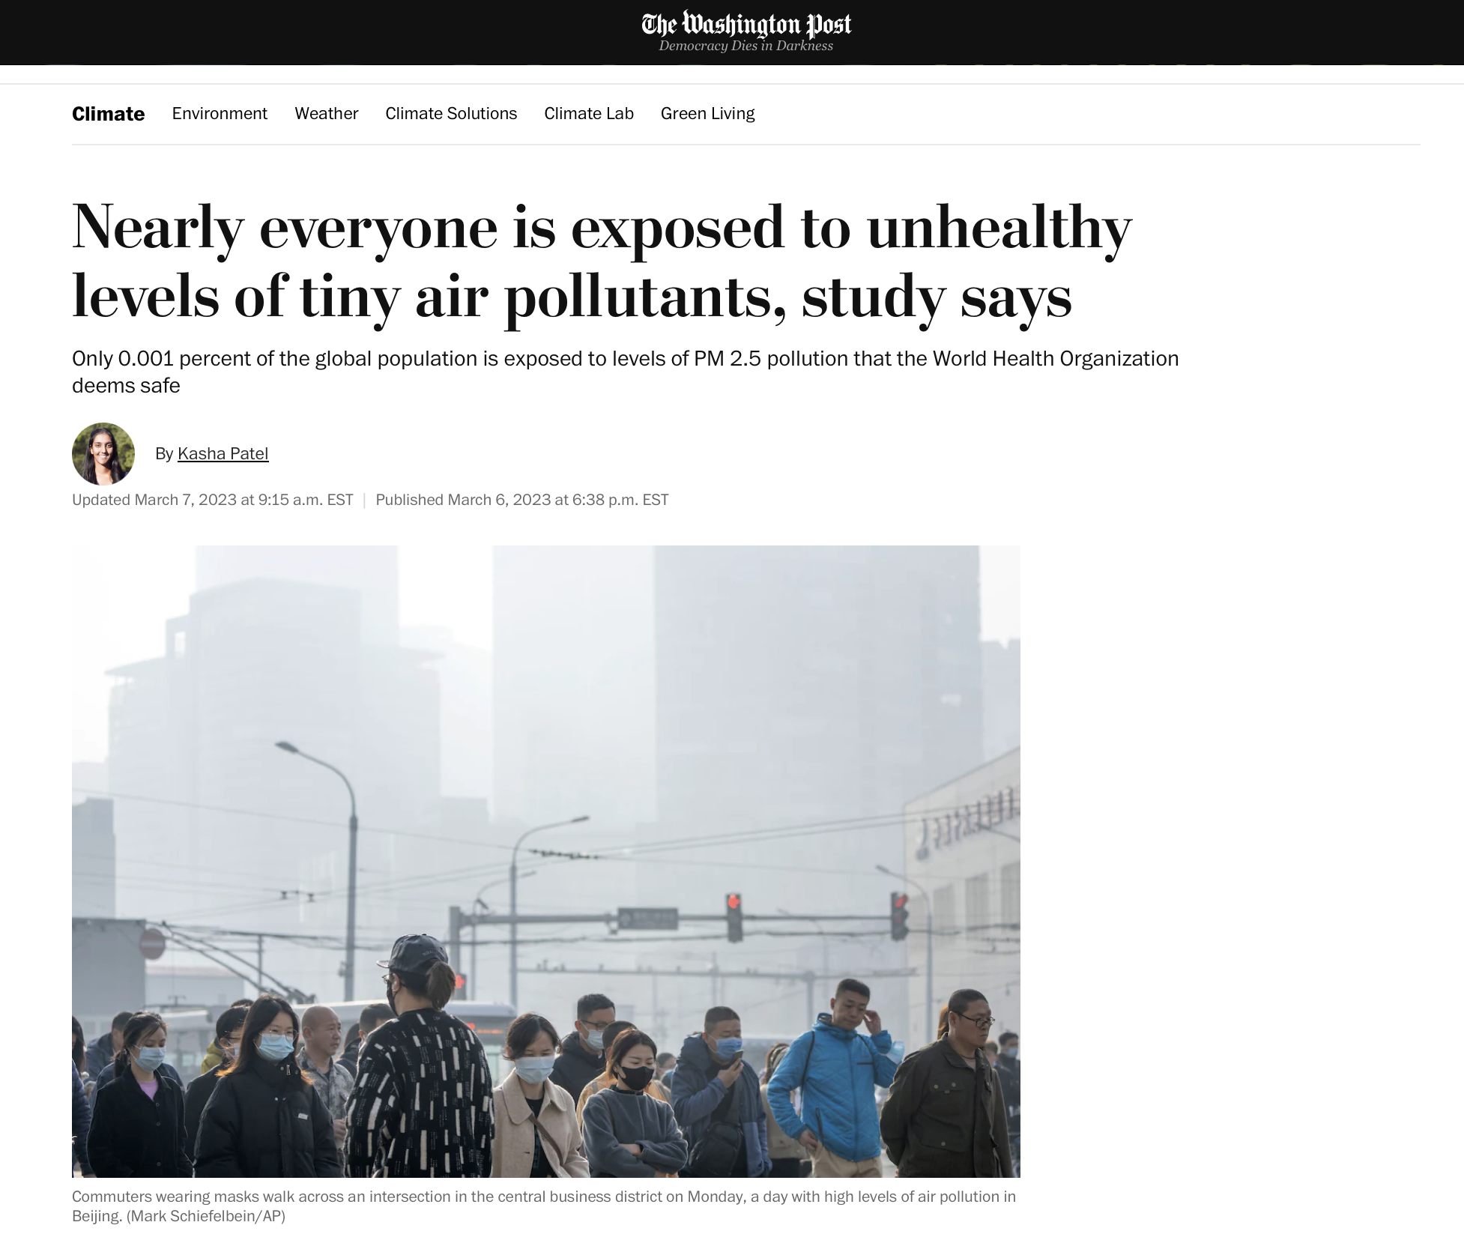

Slide 10
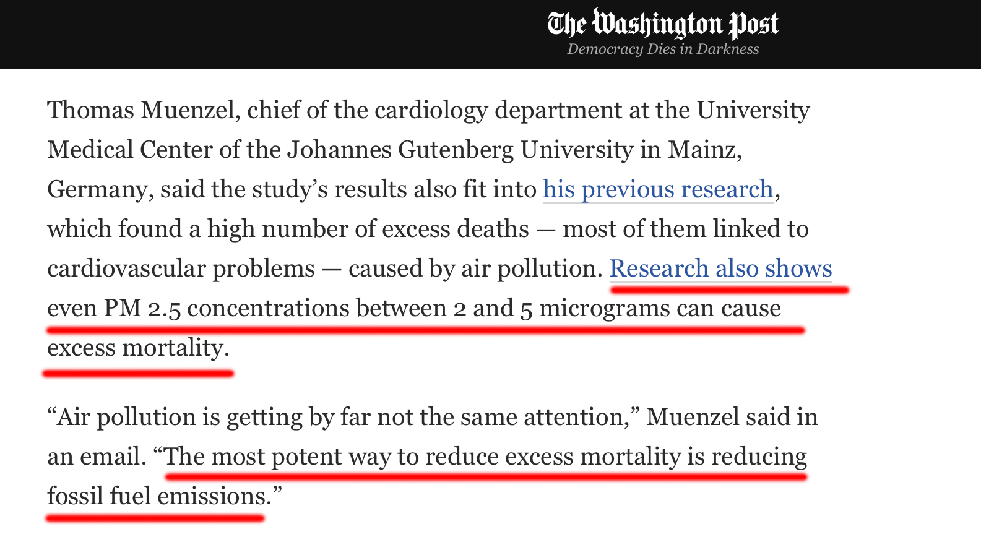

Slide 11
Key Issue
Does PM_{2.5} kill
anyone?

Slide 12
EPA relies on three lines of evidence.
Epidemiology – statistical study of disease in human populations
Animal toxicology – poisoning animals
Controlled human clinical studies – poisoning people
Statistics + Biological Plausibility = Causation

Slide 13
July 2011 Challenge

Slide 14
What does the PM_{2.5} epidemiology show? Nothing.

Slide 15
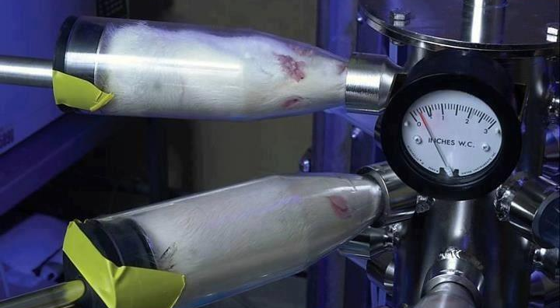
What does the PM_{2.5} animal toxicology show? Nothing.
Not a single animal
has been killed
despite massive exposures.

Slide 16
What do the PM_{2.5} human experiments show? Nothing.
Not a single human
has been killed or harmed
despite massive exposures.

Slide 17
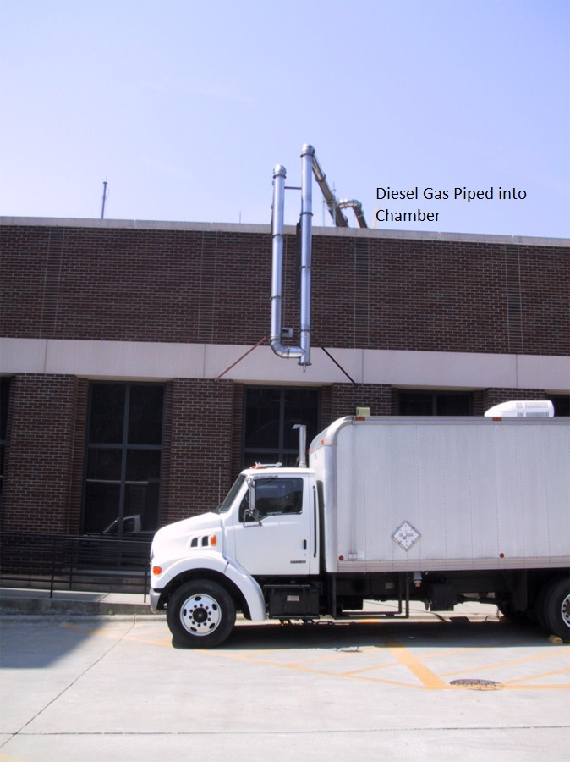
EPA piped diesel exhaust to human guinea pigs…

Slide 18
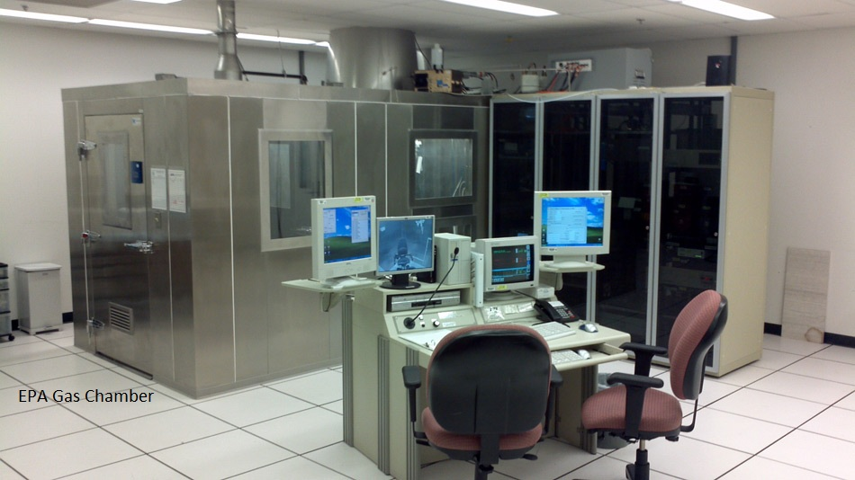
… sitting in a gas chamber.

Slide 19
Real-World PM_{2.5} Exposures
Historical incidents of deadly air pollution
Meuse Valley (1930), Donora (1948), London (1952-53)
Current instances of non-deadly air pollution
China, India, wildfires
Occupational exposures
Coal miners, diesel workers
Smoking
One cigarette = One month of PM_{2.5} in average air

Slide 20
July 2011 Challenge Still Unmet

Slide 21
How does EPA get away with it?
Epidemiology. Few know anything about it. The few that do know are either part of the con or are intimidated into silence.
Animal/Human exposure studies. Claim ‘subclinical’ effects. But subclinical effects are not health effects, much less death.

Slide 22
Is it just Steve Milloy?
1996. EPA’s Clean Air Scientific Advisory Committee (CASAC) denied EPA’s claim that PM_{2.5} killed anyone.
2013-2021. House bills & Trump EPA regulation against secret science.
2017. Enstrom redo of key 1995 PM_{2.5} study.
2017. Study of every death in California between 2000-2012 reports no statistical association between PM_{2.5} and death.
2017. Trump reforms CASAC.
2019. CASAC denied EPA’s PM_{2.5} claims in their entirety.
2021. Biden EPA fires Trump CASAC members.

Slide 23
Good and Bad News
Bad News. Very difficult to turn public comments on EPA science into winning lawsuits.
Problem: Judges reluctant to re-examine EPA science.
Good News. Young v. EPA now at DC Circuit.
Issue: Did Congress intend for EPA to rig Clean Air Act-mandated peer review?

Slide 24
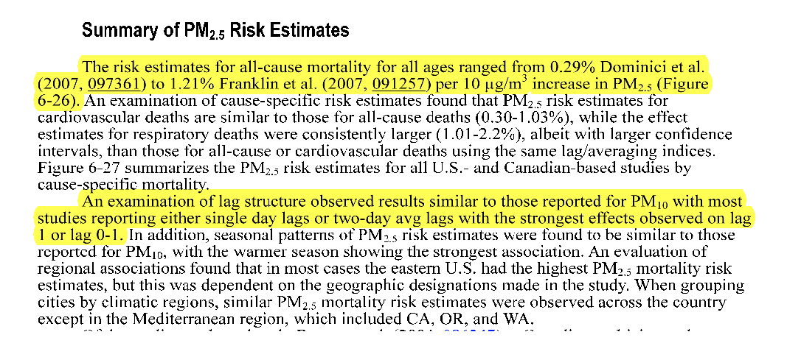
Four-Star Crazy (1/4)
EPA says PM_{2.5} is the most
toxic substance known to man.

Slide 25
Four-Star Crazy (2/4)

Slide 26
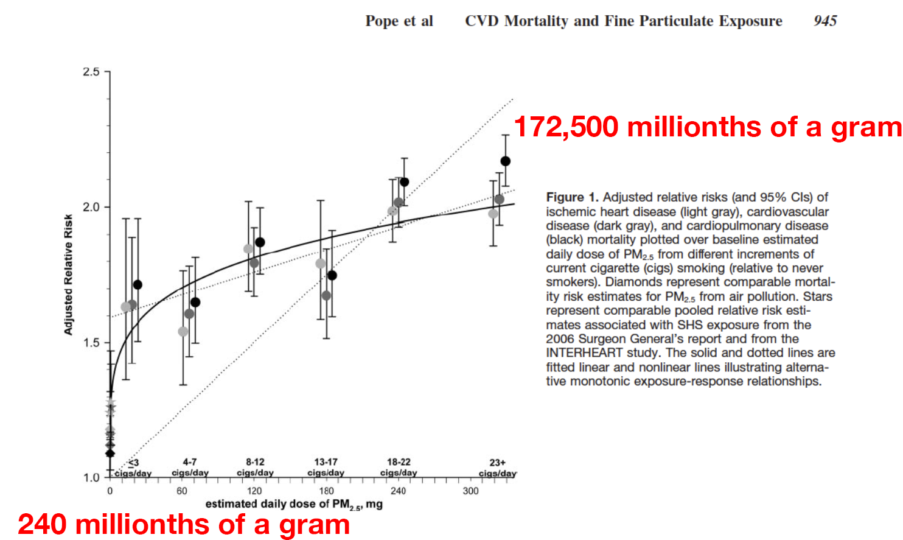
Four-Star Crazy (3/4)
EPA-funded researcher claims PM_{2.5}
far more dangerous than smoking.

Slide 27
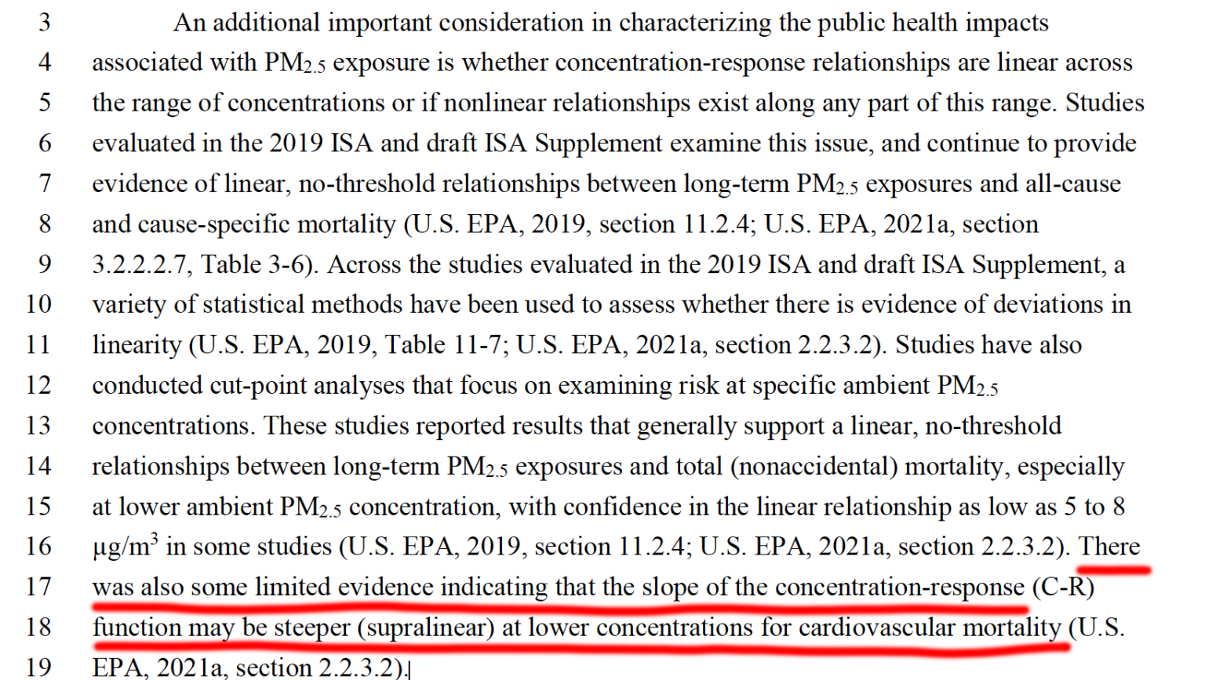
Four-Star Crazy (4/4)
EPA suggests cleaner air is deadlier air.

