Slide 1
Air Farce: The EPA’s Regulatory ‘Science’ on Airborne Particles
By Steve Milloy
Cato Institute
June 25, 2015

Slide 2
Who is Steve Milloy?
Education
B.A., Natural Sciences, Johns Hopkins University
Masters, Biostatistics, Johns Hopkins University
J.D., University of Baltimore,
L.L.M., Securities Regulation, Georgetown University
Work
SEC & broker-dealers
Led and affiliated with free market think tanks
Consultant to Fortune 50 companies
‘Junk Science’ columnist for FoxNews.com
Mutual fund co-founder, portfolio manager
Executive for coal company

Slide 3
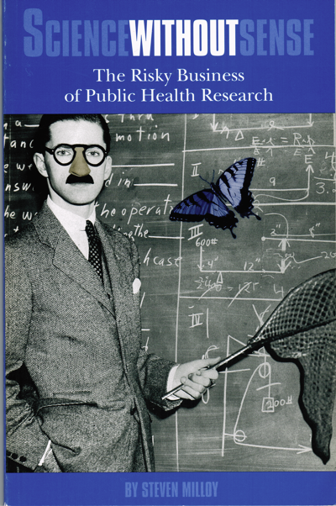

Slide 4
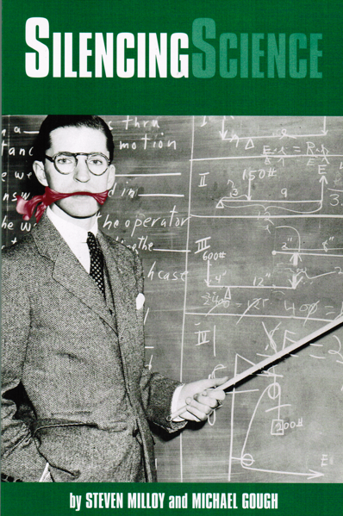

Slide 5
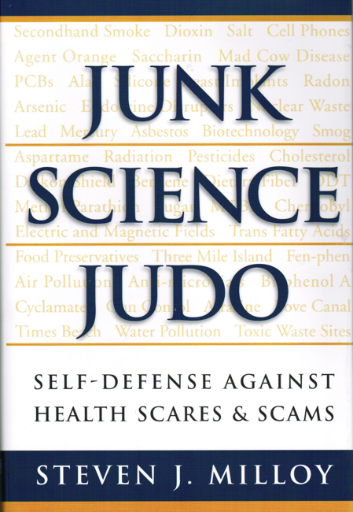

Slide 6
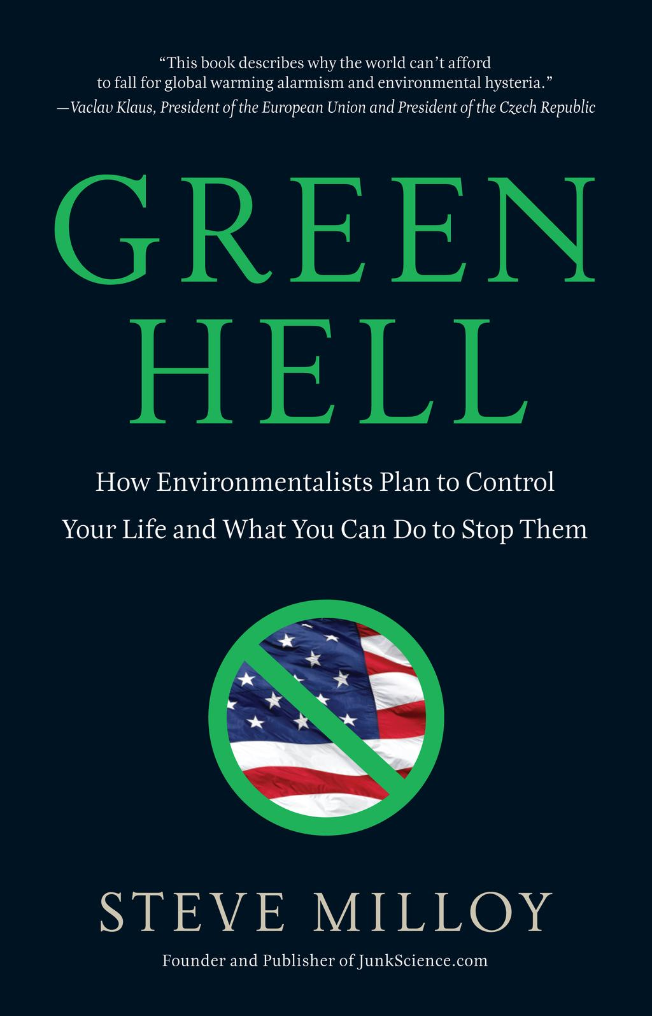

Slide 7
Disclosure
I am ‘biased’ in favor:
Limited government
Individual liberty
Free enterprise
Facts and reality
I have earned a living for the past 25+ years by advocating for the above as a
Consultant to businesses
Think tanker & activist
Publisher & author
Mutual fund manager
Corporate executive
Anyone who appreciates my biases is free to contribute to my efforts.

Slide 8
Why are we here? My biases are under assault!
The U.S. Environmental Protection Agency (EPA) is knowingly using:
Junk science,
an Orwellian denial of reality, and
Pick one:
A callous disregard of morality; or
A blatant lie
in its endless effort to expand government control of virtually every aspect of our lives via environmental regulation.

Slide 9
What is EPA doing?
Recent EPA air quality regulations have contributed greatly to the ongoing devastation of the coal industry and coal communities
Cross-State Air Pollution Rule (CSAPR)
Mercury Air Transport Standard (MATS)
The EPA’s proposed global warming regulations (aka the Clean Power Plan) represent a government redesign/takeover of the electricity grid and foreshadow government control of the economy via climate hysteria.
The EPA endlessly tightens air quality standards for so-called ‘criteria pollutants’ like ozone and PM

Slide 10
Airborne Particles Are Key to EPA’s Efforts
Fine particulate matter, called ‘PM_{2.5}’
Dust, soot, gaseous material
2.5 millionths of a meter wide (about 1/20 the width of a human hair)
Produced by burning
Smokestacks, chimneys
Tailpipes
Forest fires
Smoking

Slide 11
Imagining PM_{2.5}

Slide 12
Three Key EPA Assumptions
Breathing PM_{2.5} kills people
Especially the elderly and/or sick
ANY inhalation of PM_{2.5} can kill
Even one molecule
Death can occur:
Short-term (within hours or days)
Long-term (after decades of inhalation)

Slide 13
In a nutshell….
EPA views PM_{2.5} as the most deadly substance known to man
No other substance kills by means of ‘any’ exposure.

Slide 14
Beware – 10 micrograms/m³ PM_{2.5}

Slide 15
Did you inhale 0 micrograms… or only 1?

Slide 16
Lest you think this exaggeration…
EPA scientific assessments:
Population death rates increase by up to 1.2% per 10 microgram/m³ increase in PM_{2.5}
Increase is from zero exposure
‘Strong evidence’ that death occurs in the ‘short-term (hours, days)’

Slide 17
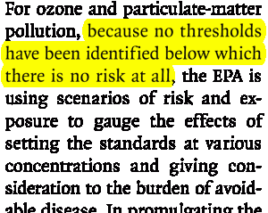
Lest you think this exaggeration (cont’d)
From Jonathan Samet, the chairman of EPA’s outside science advisory group (Clean Air Science Advisory Committee):

Slide 18
Lest you think this exaggeration (cont’d)
Letter from EPA’s Gina McCarthy to Rep. Fred Upton, February 2012:

Slide 19
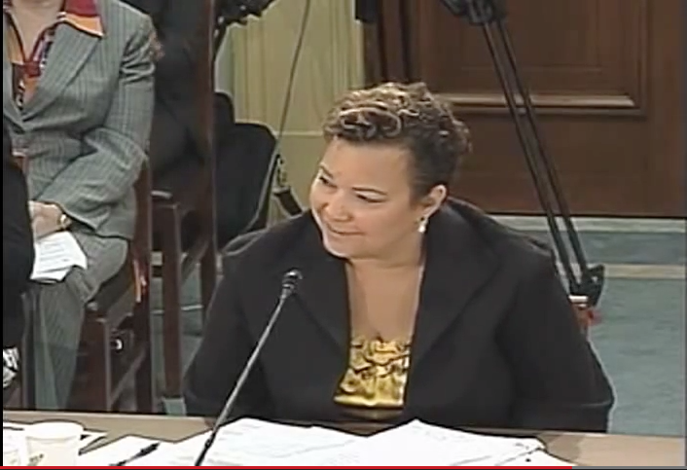
Lest you think this exaggeration (cont’d)
EPA chief Lisa Jackson testimony to a House subcommittee, September 2011:

Slide 20
Lest you think this exaggeration (cont’d)
EPA chief Lisa Jackson testimony to a House subcommittee, September 2011:
Particulate matter causes premature death. It doesn’t make you sick. It’s directly causal to dying sooner than you should.
If we could reduce particulate matter to levels that are healthy we would have an identical impact to finding a cure for cancer.

Slide 21
Jumping the Shark
EPA chief says PM_{2.5} kills
570,000
Americans per year*
* - About 23% of annual U.S. deaths

Slide 22
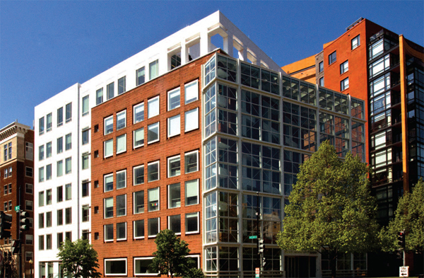
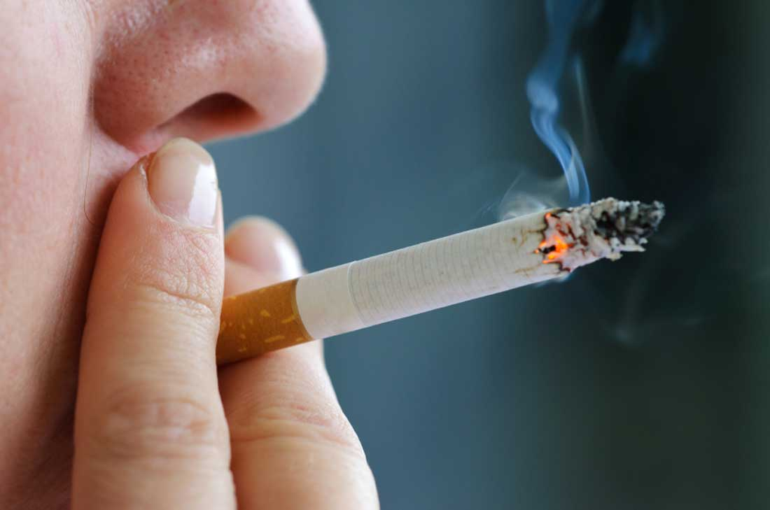
Jumping the Shark (cont’d)
Blue sky breathing kills 570,000/year
Smoking kills 440,000/year

Slide 23
How does PM_{2.5} help EPA’s agenda?
Saving thousands of lives is good PR
CSAPR & MATS rules – up to 34,000 lives per year
Clean Power Plan – up to 6,600 lives per year
Short-circuit debate over costs, benefits of rules
Each life ‘saved’ worth about $10 million
CSAPR & MATS benefits up to $380 billion/yr
Entire coal industry contribution to GDP is ~ $225 billion/yr
Clean Power Plan benefits up to $93 billion/yr
Coal industry cost estimate is ~$50 billion/yr
Industry cost estimate cannot compete with EPA’s claimed PM_{2.5} benefits estimates

Slide 24
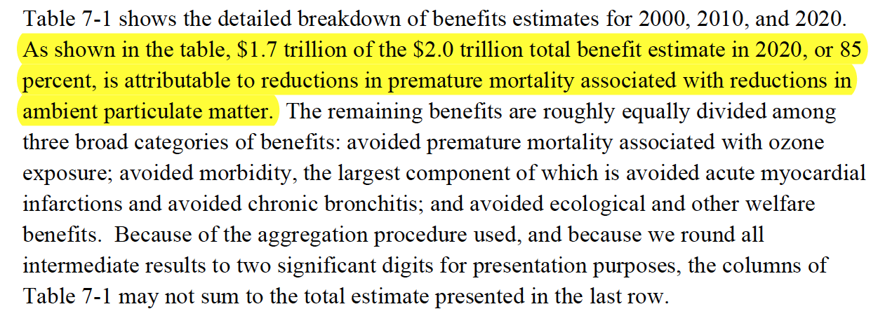
How does PM_{2.5} help EPA’s agenda? (cont’d)
EPA claims that by 2020, the Clean Air Act will be providing $2 trillion worth of benefits every year – 85% from reducing PM_{2.5} deaths.

Slide 25
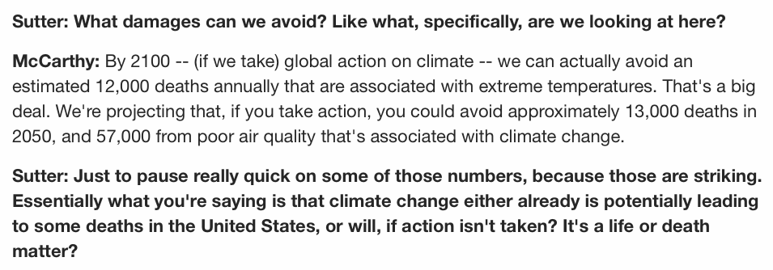
Late-Breaking Claim
CNN interview with EPA chief Gina McCarthy, June 22, 2015:

Slide 26
Challenge to EPA

Slide 27
EPA’s Response
EPA Deputy Administrator to Congress, July 20, 2011:
… these are not fabricated, they’re based on peer-reviewed science, both clinical and epidemiological studies.

Slide 28
EPA Claims 3 Lines of Evidence Support PM_{2.5} Claims
Epidemiology studies
Study of disease patterns in human populations
Toxicology studies
See what happens when you poison animals
Clinical studies/human testing
See what happens when you poison people

Slide 29
PM_{2.5} Epidemiology
EPA claims:
Hundreds/thousands of studies support notion that PM_{2.5} kills
All report similar statistical correlations between outdoor monitor measurements of PM_{2.5} and increased rates of death

Slide 30
PM_{2.5} Epidemiology Reality
Poor quality data -- GIGO
No actual exposure data
No determinations on cause of death
Weak correlations – harvesting statistical noise, at best
Ignore studies showing no correlation
Corrupt review process
EPA pays researchers to produce studies and then hires same researchers to review their own/colleagues’ research.
EPA admits in litigation over PM_{2.5}: ‘Epidemiologic studies do not generally provide evidence of direct causation.’

Slide 31
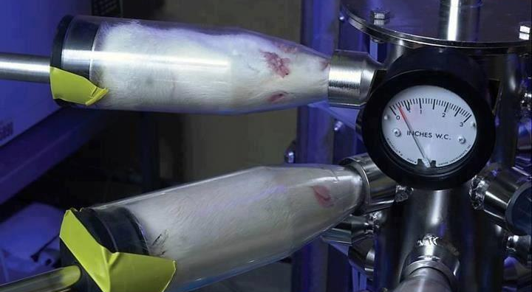
PM_{2.5} Toxicology Reality
Animals exposed to PM_{2.5} at levels 100s times greater than outdoor air.
NO animal has ever died in an experimental setting from PM_{2.5}.

Slide 32
PM_{2.5} Clinical/Human Testing Reality

Slide 33
PM_{2.5} Human Testing Reality (cont’d)

Slide 34
PM_{2.5} Human Testing Reality (cont’d)

Slide 35
PM_{2.5} Human Testing Reality (cont’d)

Slide 36
PM_{2.5} Human Testing Reality (cont’d)

Slide 37
What does EPA tell its human guinea pigs?
No disclosure of risk of death!

Slide 38
Recall: EPA says any PM_{2.5} can kill

Slide 39
Recall: 10 micrograms US average

Slide 40
PM_{2.5} Human Testing Reality (cont’d)

Slide 41
PM_{2.5} Human Testing Reality (cont’d)
The PM_{2.5} concentration level of 600 micrograms per cubic meter is:
60 times greater than PM_{2.5} in average U.S. air

Slide 42
PM_{2.5} Human Testing Reality (cont’d)
The PM_{2.5} concentration level of 600 micrograms per cubic meter is:
60 times greater than PM_{2.5} in average U.S. air
17 times greater than the maximum PM_{2.5} allowed by EPA in U.S. air (35 micrograms)

Slide 43
PM_{2.5} Human Testing Reality (cont’d)
The PM_{2.5} concentration level of 600 micrograms per cubic meter is:
60 times greater than PM_{2.5} in average U.S. air
17 times greater than the maximum PM_{2.5} allowed by EPA in U.S. air (35 micrograms)
Undefined times greater than PM_{2.5} exposure EPA says is safe. (Anything divided by zero is ‘undefined’.)

Slide 44
PM_{2.5} Human Testing Reality (cont’d)
Why is EPA testing high concentrations of PM_{2.5} on elderly and sick people? EPA told a federal court:

Slide 45
PM_{2.5} Human Testing Reality (cont’d)
What are the results of this testing?

Slide 46
PM_{2.5} Human Testing Reality (cont’d)
What are the results of this testing?
Anyone killed?

Slide 47
PM_{2.5} Human Testing Reality (cont’d)
What are the results of this testing?
Anyone killed?
NO!

Slide 48
EPA’s PM_{2.5} Logical Box
If PM_{2.5} as lethal as EPA says, it has committed crimes via its human testing program.
Violated every law and principle concerning human testing since the Nuremberg Code
If crimes not committed, EPA has lied to the public and Congress about the dangers of PM_{2.5}.
No escape hatch.

Slide 49
PM_{2.5} Reality
Short-term exposures
Recall any inhalation of PM_{2.5} can kill in hours, says EPA

Slide 50
PM_{2.5} Reality
Short-term exposures
Recall any inhalation of PM_{2.5} can kill in hours, says EPA
From average outdoor, a breather inhales about 10 micrograms per hour

Slide 51
PM_{2.5} Reality
Short-term exposures
Recall any inhalation of PM_{2.5} can kill in hours, says EPA
From average outdoor, a breather inhales about 10 micrograms per hour
In a car with smoker and windows closed, occupants inhale up to 4,000 micrograms per hour

Slide 52
PM_{2.5} Reality
Short-term exposures
Recall any inhalation of PM_{2.5} can kill in hours, says EPA
From average outdoor air, a breather inhales about 10 micrograms per hour
In a car with smoker and windows closed, occupants inhale up to 4,000 micrograms per hour
From smoking, a smoker can inhale 40,000 micrograms in 5-10 minutes.

Slide 53
PM_{2.5} Reality
Short-term exposures
Recall any inhalation of PM_{2.5} can kill in hours, says EPA
From average outdoor air, a breather inhales about 10 micrograms per hour
In a car with smoker and windows closed, occupants inhale up to 4,000 micrograms per hour
From a cigarette, a smoker can inhale 40,000 micrograms in 5-10 minutes.
From a marijuana joint, a smoker can inhale up to 180,000 micrograms in minutes.

Slide 54
PM_{2.5} Reality
Short-term exposures
Recall any inhalation of PM_{2.5} can kill in hours, says EPA
From average outdoor air, a breather inhales about 10 micrograms per hour
In a car with smoker and the windows closed, occupants inhale up to 4,000 micrograms per hour
From a cigarette, a smoker can inhale 40,000 micrograms in 5-10 minutes.
From a marijuana joint, a smoker can inhale up to 180,000 micrograms in minutes.
In a hookah bar, one can be exposed to the equivalent of 100 cigarettes in one session.

Slide 55
PM_{2.5} Reality (cont’d)
Long-term exposures
The sorts of decades exposures to PM_{2.5} supposedly examined by EPA’s epidemiology studies

Slide 56
PM_{2.5} Reality (cont’d)
Long-term exposures
The sorts of decades exposures to PM_{2.5} supposedly examined by EPA’s epidemiology studies
If PM_{2.5} can kill in hours, how does EPA know that a long-term death wasn’t really a short-term death?

Slide 57
PM_{2.5} Reality (cont’d)
Long-term exposures
The sorts of exposures to PM_{2.5} studied in EPA’s epidemiology studies
Mining exposures to diesel particles (95% of which are PM_{2.5)} can hit 2,000 micrograms/hr
But miners have greater life expectancy!

Slide 58
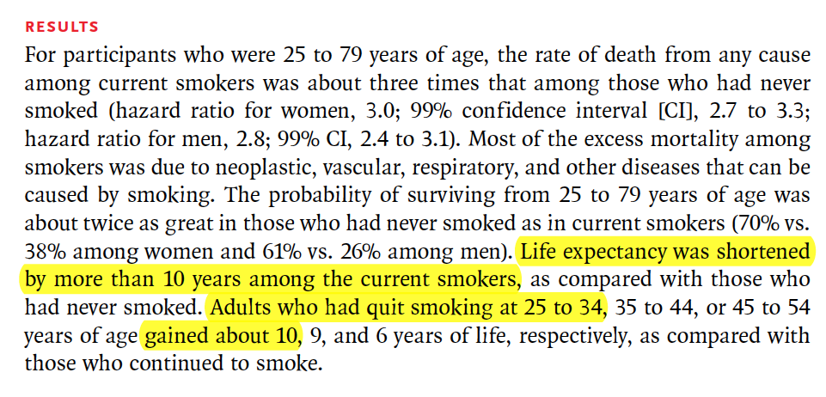
PM_{2.5} Reality (cont’d)

Slide 59
PM_{2.5} Reality (cont’d)
Lifetime nonsmoker living in DC for 80 years inhales 7 million micrograms of PM_{2.5}.
15-year, ½ pack/day smoker in DC for 80 years inhales 7 million micrograms (DC air) plus 2.19 billion micrograms of PM_{2.5} from smoking.
So a 15-yr DC smoker inhales 314 times MORE PM_{2.5} over the course of a lifetime but has the same life expectancy as a DC nonsmoker.

Slide 60
PM_{2.5} Reality (cont’d) Nonsmoker vs. 15-yr Smoker

Slide 61
PM_{2.5} Reality (cont’d)
Washington, DC
PM_{2.5} = 10 micrograms
Life expectancy = 76.5

Slide 62
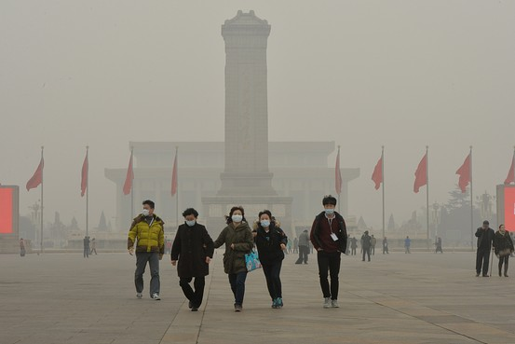
PM_{2.5} Reality (cont’d)
Washington, DC
PM_{2.5} ~ 10 micrograms
Life expectancy ~ 76.5
Beijing, China
PM ~ 100 micrograms
Life expectancy ~80+

Slide 63
How Does EPA Get Away With It?
EPA PM_{2.5} claims fail tests of:
Epidemiology
Toxicology
Human experiments
Reality

Slide 64
How Does EPA Get Away With It?
EPA PM_{2.5} claims fail tests of:
Epidemiology
Toxicology
Human experiments
Reality
So EPA relies on:
Industry fear/inability to seriously confront EPA
Public ignorance, confusion, apathy
Activist groups/captured media parrot EPA
Congressional inaction (lack of time, complexity of issue, EPA obfuscation/stonewalling/defiance, need EPA favors)

Slide 65
Example of EPA Defiance: Secret Science
A key part of the scientific method is replication of study results
To replicate a study, an independent scientist needs access to the study’s data and methodology
EPA has refused to make available to independent researchers the data used in its key PM_{2.5} epidemiology studies, despite:
Taxpayers paid for the studies and data
Industry requests dating back to 1994
Multiple Congressional requests dating back to 1997, including a 2013 subpoena
Secret Science Reform Act of 2015 (HR 1030)
Passed by House and Senate EPW Committee

Slide 66
Circumventing EPA’s Secret Science:
Need to create a new data set, but how?
California to the rescue
Electronic death certificates for all California deaths
Compared state air quality data with deaths on a daily basis
NO correlation found for daily PM_{2.5} (or ozone) and daily death counts

Slide 67
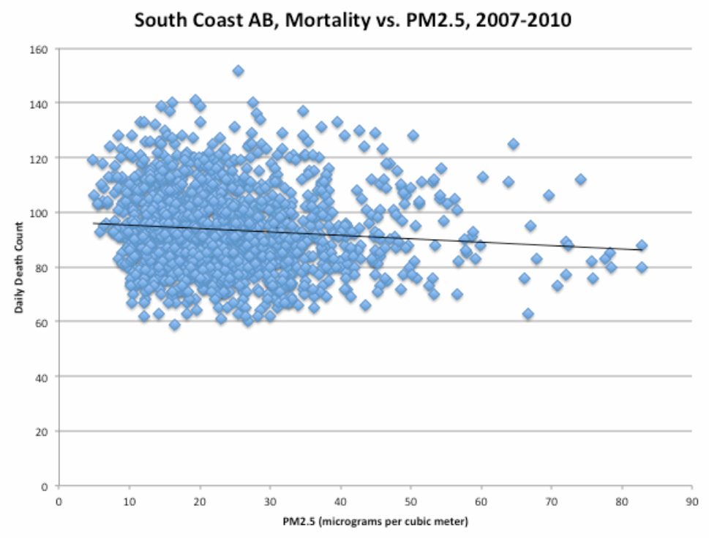
￼
￼

Slide 68
Circumventing EPA’s Secret Science: The California Study
Largest, newest, most comprehensive, best-conducted epidemiology on PM_{2.5} of all time
Covers 94% of the deaths in California for the period 2000-2012
Conducted by world-class statisticians
Study shows NO CORRELATION between PM_{2.5} (or ozone) and short-term death.
Raw data to be made available to public
NO SECRET SCIENCE
To be published summer 2015

Slide 69
Conclusion: EPA’s claim that PM_{2.5} kills is more than merely false. It is fraudulent.

Slide 70
Recall: EPA’s 2$ Trillion Claim
EPA claims that by 2020, the Clean Air Act will be providing $2 trillion worth of benefits every year – 85% from reducing PM_{2.5} deaths.

Slide 71
EPA’s PM_{2.5} Rap Sheet
Corrupted science
Denied reality
Behaved immorally, if not criminally
Lied to the public, Congress
Unaccountable to Congress
Rarely reined in by courts
Wealth – and health – destroying
Constraining the economy, individual liberties

Slide 72
What to do?

Slide 73
What to do?
End secret science.

Slide 74
What to do?
End secret science.
End corrupt peer review.

Slide 75
What to do?
End secret science.
End corrupt peer review.
Remove EPA from scientific research.

Slide 76
What to do?
End secret science.
End corrupt peer review.
Remove EPA from scientific research.
Mandate independent, reality-based cost-benefit analysis.

Slide 77
What to do?
End secret science.
End corrupt peer review.
Remove EPA from scientific research.
Mandate independent, reality-based cost-benefit analysis.
Require major regulations be approved by Congress.

Slide 78
What to do?
End secret science.
End corrupt peer review.
Remove EPA from scientific research.
Mandate independent, reality-based cost-benefit analysis.
Require major regulations be approved by Congress.
Expand judicial review of EPA actions.

Slide 79
What to do?
End secret science.
End corrupt peer review.
Remove EPA from scientific research.
Mandate independent, reality-based cost-benefit analysis.
Require major regulations be approved by Congress.
Expand judicial review of EPA actions.
Cut EPA’s budget & devolve responsibilities to states.

Slide 80
What to do?
End secret science.
End corrupt peer review.
Remove EPA from scientific research.
Mandate independent, reality-based cost-benefit analysis.
Require major regulations be approved by Congress.
Expand judicial review of EPA and reduce agency discretion.
Cut EPA’s budget & devolve responsibilities to states.
Update environmental laws to reflect 21st century environmental reality and experience.

Slide 81
